Slide 1


Critical Reading
Academic & Professional Writing

Slide 2
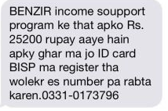

Slide 3
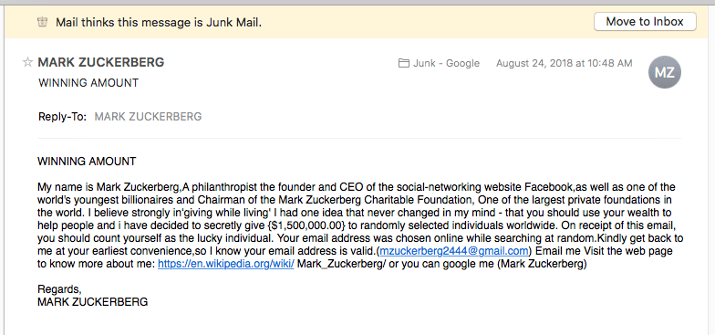

Slide 4
Critical Reading
  Who wrote the content and why?
  Is it fact or opinion?
  Produced arguments are well justified?
  Presented evidences are valid?

Slide 5
  ● Introduction
  Critical Thinking is:
  All about understanding a text by:
  Analyzing
  Interpreting
  Evaluating

Slide 6
  ● Analysis: Looking for Patterns
What is the thesis or main idea?
What are the supporting arguments?
Are there any examples and supporting details?

Slide 7
  ● Interpretation:
  The debate, author and the text engaging with in that time?
  What kind of reasoning is employed? (historical, political, psychological)
  Is my reading biased? Am I imposing 21st century ideas or values on text?

Slide 8
  ● Evaluation: What is the intellectual/cognitive/aesthetic/moral and practical value of the text
  Is the conclusion true and original form of work?
  Evidence and reasoning support the thesis?
  Are the arguments, consistent, logical and convincing?
  Are the sources reliable?

Slide 9
  Fact Vs Opinion
  Distinguishing between fact and opinion is a vital critical thinking and reasoning skill.
  Fact: Can be verified for accuracy and authenticity.
  Opinion: It cannot be verified for accuracy.

Slide 10
Examples of Facts
1. Statistically, women live longer than men.
Most buses weigh more than most cars.
Your heart pumps blood through your body.

Slide 11
Opinions are statements that cannot be proven.
Opinions can be argued.
Opinions may be supported with facts.
Opinions cannot be proven.
Examples
Golf is boring.
Pizza is delicious.
Math is the hardest subject.

Slide 12
It is not appropriate to watch funny cat videos during school.
There are fewer panda bears in the world than grizzly bears.
Chocolate milk tastes better than regular milk.
Michael Jordan has a career average of 30.4 points per game.
Traveling in Asia is more fun than traveling in Europe.
Oranges contain both calcium and vitamin C.
The more money someone has the more successful they are.
The first day of the school year is scary.
Your birthday comes only one day a year.
Fruits and vegetables are part of a healthy diet.

Slide 13
Opinion.
Fact.
Opinion.
Fact.
Opinion.
Fact.
Opinion.
Opinion
Fact.
Fact.

Slide 14
Read the paragraph. Underline the sentences that are opinions.
Rain is important for plants and animals. It’s known as precipitation in the water cycle, and occurs after evaporation. It’s fun to play in it as well! You can splash in rain puddles or walk outside with an umbrella. When it gets very cold outside, rain becomes snow or hail. Snow is even more fun than rain. Everyone loves building snowmen and throwing snowballs. Our planet has all kinds of different weather patterns.

Slide 15
Rain is important for plants and animals. It’s known as precipitation in the water cycle, and occurs after evaporation. It’s fun to play in it as well! You can splash in rain puddles or walk outside with an umbrella. When it gets very cold outside, rain becomes snow or hail. Snow is even more fun than rain. Everyone loves building snowmen and throwing snowballs. Our planet has all kinds of different weather patterns.

Slide 16
Text Structure

Slide 17
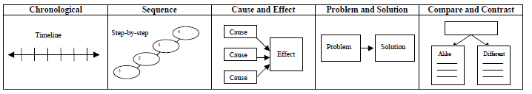

Slide 18
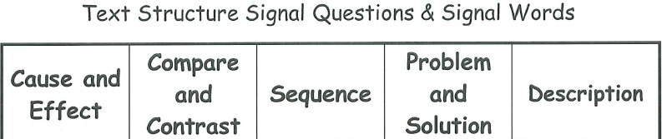
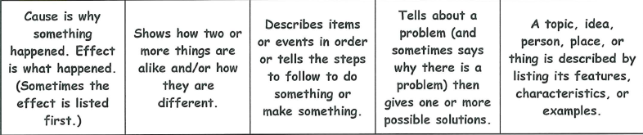

Slide 19
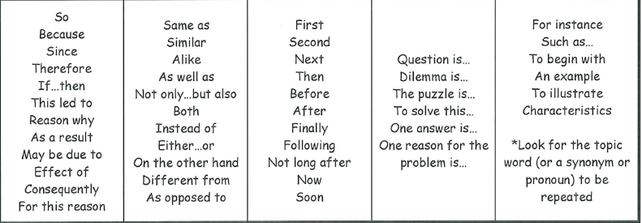

Slide 20
Text Structure Activity

Slide 21
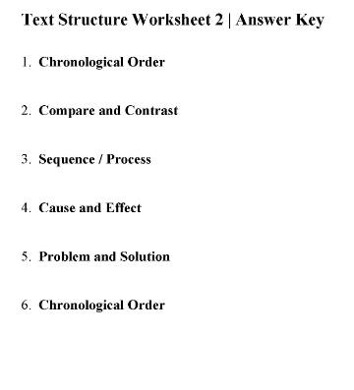

Slide 22
  ●Making Inferences
  It is a comprehension strategy to “read between the lines” to make
  connection and draw conclusions about the meaning and purpose of
  the text.
  Writers don’t explicitly give all the details and leave clues for the
  reader to pick in order to understand the meaning.

Slide 23
  ●Example:
  You are at your friends house, and she yells, “hey don’t sit there,
  Amna came with her baby again”.
  Blood cholesterol was used to be thought as a problem only for adults
  The day Danish bought 6 lottery tickets, he quits work the next day.

Slide 24
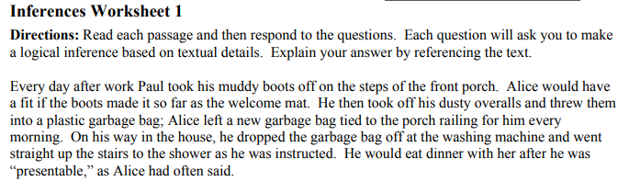

Slide 25
What type of job does Paul do?
Describe Alice
What relationship do Paul and Alice have?

Slide 26
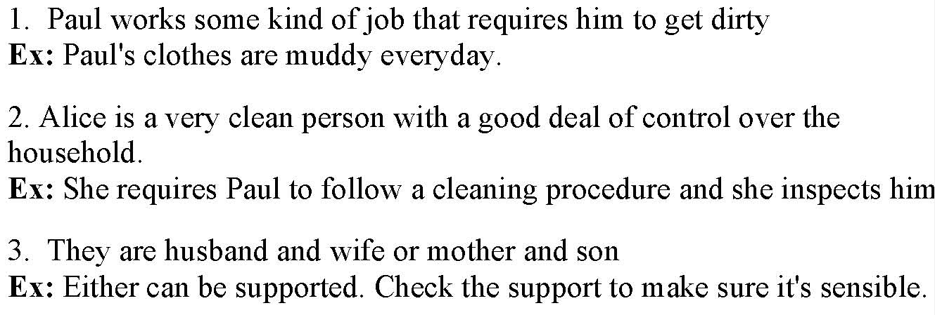

Slide 27
Crack! Thunder struck and rain poured. Max stared blankly out the window, trying to contain his emotions that raged like the weather. He was beginning to lose it. Dropping the kite from his hand, Max broke out into full sobs. His mother comforted him, “There, there, Max. We’ll just find something else to do.” She began to unpack the picnic basket that was on the counter and offered him a sandwich. Max snapped, “I don’t wanna sand-mich!” A flash from the sky lit up the living room. Boom! Mom sighed.
Why is Max upset?
What was Mom planning on doing today?

Slide 28
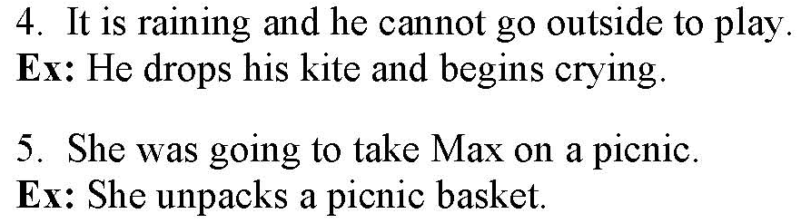

Slide 29
“Tommy!” Mom called out as she walked in the front door. “Tommy,” she continued shouting, “I sure could use some help with these groceries. There was still no reply. Mom walked into the kitchen to put the grocery bags down on the counter when she noticed shattered glass from the picture window all over the living room floor and a baseball not far from there. “I’m going to kill you, Tommy!” Mom yelled to herself as she realized that Tommy’s shoes were gone.
What happened to the window?
Why did Tommy leave?

Slide 30
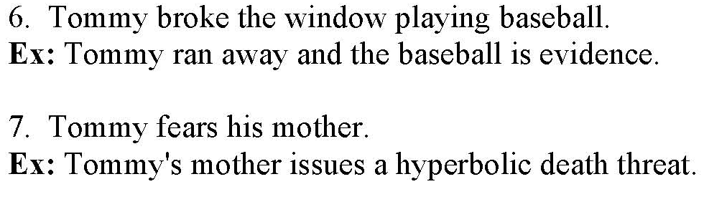

Slide 31
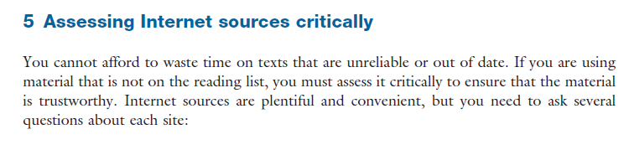

Slide 32
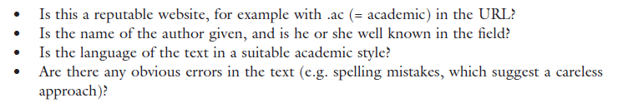

Slide 33
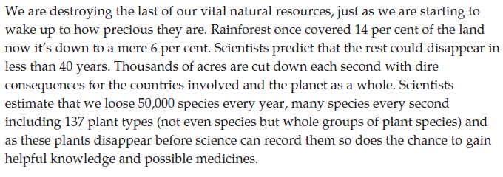

Slide 34
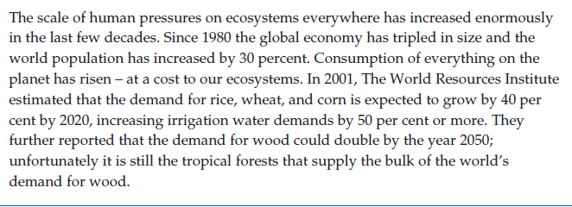

Slide 35
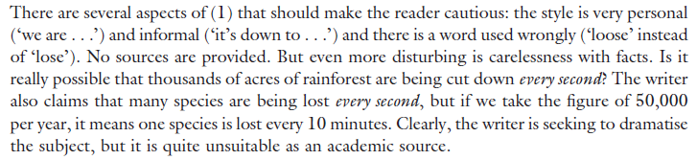

Slide 36
  References:
  1. 501 Reading Comprehension Questions (4th ed.). (2010). New York: Learning Express.
  2. https://www.utsc.utoronto.ca/twc/sites/utsc.utoronto.ca.twc/files/resource-files/CriticalReading.pdf
  3. http://aeo.sllf.qmul.ac.uk/Files/CriticalThinking/fact%20or%20opinion.pdf

